Slide 1

Do Social media networks strengthen or degrade human relationships?”
Presented by :
chaima sassi

Slide 2
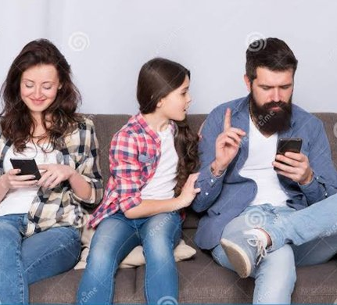
Social media is a disaster and degrade human relations
Social media use is a ubiquitous phenomenon .Research shows that 90% of adults own a smartphone .Additional research indicates that 72% of Americans and an average of 43% of the world own a smartphone while more than 71% of American adolescents, ages 13-17, regularly use Facebook.

Slide 3
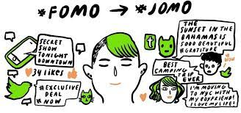
It causes FOMO and anexiety
Fear of missing out (FOMO) is the psychological mentality that individuals might be missing out on a social opportunity or situation. This mentality requires that they stay connected with others and updated about what their friends are doing.
Closely related to FOMO is anxiety which manifests itself frequently in the lives of those who use social media and experience FOMO. Cheever, Rosen, Carrier, and Chavez (2014) sought to explore when anxiety manifested itself in the lives of college students who were separated from their cell phones

Slide 4
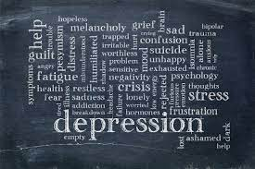
It causes also Depression and loneliness
depression and loneliness contribute to the mental health problems caused by social media use
In countries where social media use is high, reports show that loneliness and depression have increased dramatically within the past decade (Pittman & Reich, 2016). There is no doubt that increased social media use and higher rates of depression and loneliness are linked , they go hand in hand with each other, but they are not the same

Slide 5
solution
Future research should examine how addictive behaviors are created or strengthened through excessive social media use. Future research should also examine what the ideal amount of time spent on social media should be. Is there an appropriate balance between too much media use and none? If there is, what is it and does moderating how much time we spend on social media influence whether it will turn into an addiction? Another idea for future research is to examine gender differences for social media usage

